Slide 1


A STUDY ON THE EDUCATIONAL PERFORMANCE OF SCHOOL STUDENTS FROM SOME SELECTED COUNTRIES GROUP 3

Slide 2
Group 3 members
Ajayi Oluwatomilayo Abiodun
Okondu Joseph Ifeanyi
Victoria Abia Ediete
Adolor Lewis
Timeyin Blankson
Muhammad Okunade
Dele Oyapidan
Ukara Evelyn Onyekachi
Nsunhusi Edwin
Bassey emmanuel
Anthony Ewoma

Slide 3




Brief description of the data set studied
This is an educational data set which is collected from learning management system (LMS) called Kalboard 360. Kalboard 360 is a multi-agent LMS, which has been designed to facilitate learning through the use of leading-edge technology.
The data is collected using a learner activity tracker tool, which called experience API (xAPI). The xAPI is a component of the training and learning architecture (TLA) that enables to monitor learning progress and learner’s actions like reading an article or watching a training video. The experience API helps the learning activity providers to determine the learner, activity and objects that describe a learning experience. The dataset consists of 480 student records and 16 features. The features are classified into three major categories:
(1) Demographic features such as gender and nationality.
(2) Academic background features such as educational stage, grade Level and section.
(3) Behavioral features such as raised hand on class, opening resources, answering survey by parents, and school satisfaction.
Source: Elaf Abu Amrieh, Thair Hamtini, and Ibrahim Aljarah, The University of Jordan, Amman, Jordan, http://www.Ibrahimaljarah.com www.ju.edu.jo
Retreived From: https://www.kaggle.com/aljarah/xAPI-Edu-Data

Slide 4
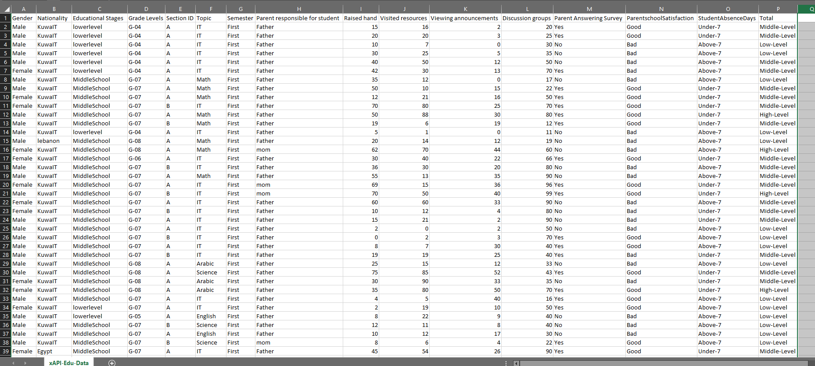

Slide 5
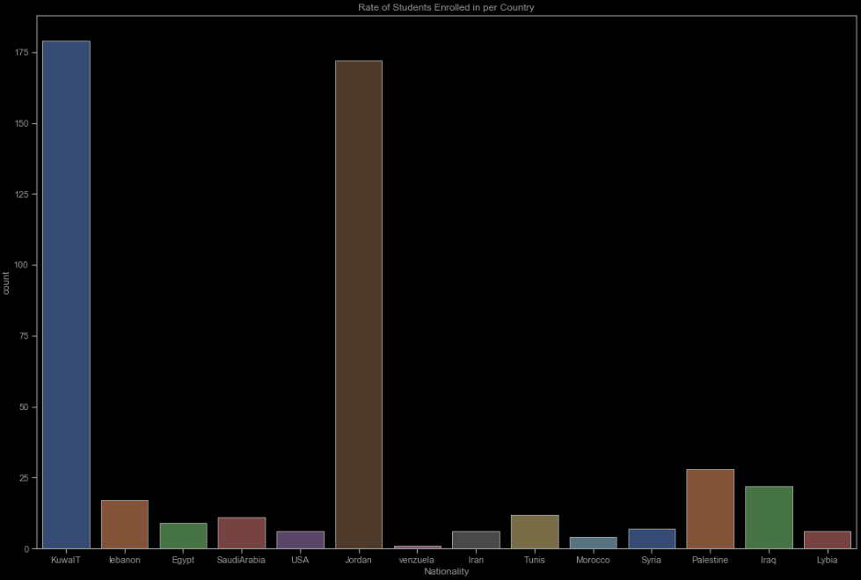
Summary of students surveyed
The dataset consists of 305 males and 175 females.
The students come from different origins such as 179 students are from Kuwait, 172 students are from Jordan, 28 students from Palestine, 22 students are from Iraq, 17 students from Lebanon, 12 from Tunis, 11 students from Saudi Arabia, 9 students from Egypt, 7 students from Syria, 6 students from USA, Iran and Libya, 4 students from Morocco and one student from Venezuela.
The topics enrolled in are IT, French, Arabic, Science, English, Biology, Spanish, Geology, Chemistry, Quran, Math, History
The students are primary and secondary school students between Grade 2 and Grade 12
STUDENTS ENROLLED IN EACH COUNTRY

Slide 6
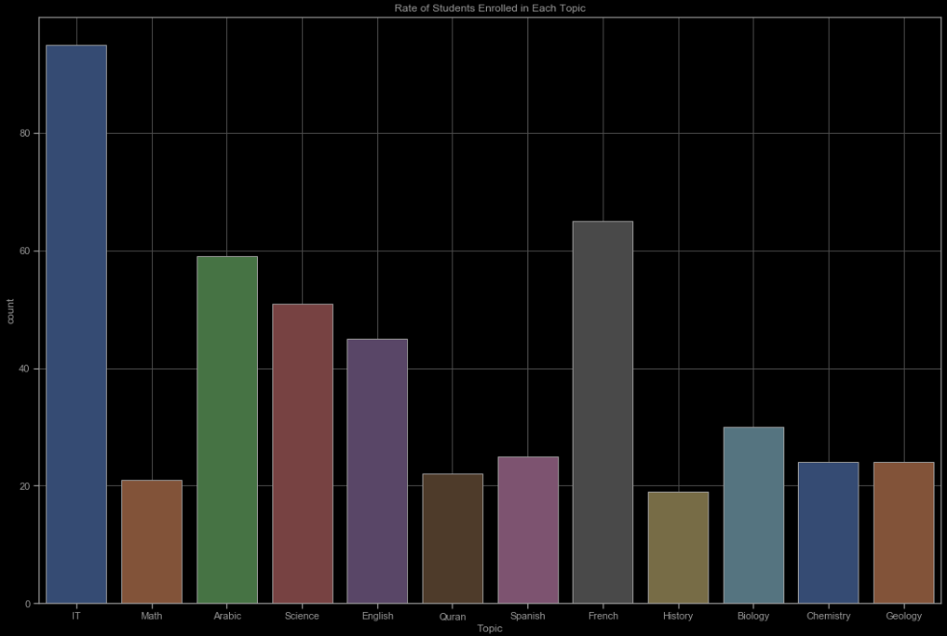
Summary of students surveyed
The dataset consists of 305 males and 175 females.
The students come from different origins such as 179 students are from Kuwait, 172 students are from Jordan, 28 students from Palestine, 22 students are from Iraq, 17 students from Lebanon, 12 from Tunis, 11 students from Saudi Arabia, 9 students from Egypt, 7 students from Syria, 6 students from USA, Iran and Libya, 4 students from Morocco and one student from Venezuela.
The topics enrolled in are IT, French, Arabic, Science, English, Biology, Spanish, Geology, Chemistry, Quran, Math, History
The students are primary and secondary school students between Grade 2 and Grade 12
RATE OF STUDENTS ENROLLED IN EACH TOPIC

Slide 7
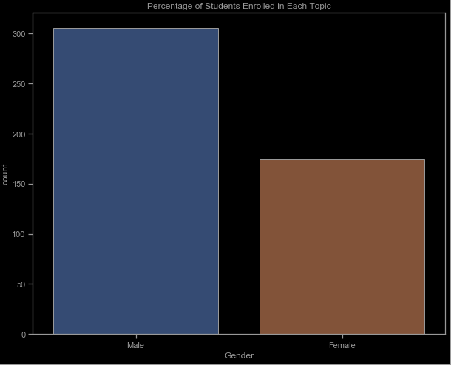
Summary of students surveyed
The dataset consists of 305 males and 175 females.
The students come from different origins such as 179 students are from Kuwait, 172 students are from Jordan, 28 students from Palestine, 22 students are from Iraq, 17 students from Lebanon, 12 from Tunis, 11 students from Saudi Arabia, 9 students from Egypt, 7 students from Syria, 6 students from USA, Iran and Libya, 4 students from Morocco and one student from Venezuela.
The topics enrolled in are IT, French, Arabic, Science, English, Biology, Spanish, Geology, Chemistry, Quran, Math, History
The students are primary and secondary school students between Grade 2 and Grade 12
GENDER OF THE STUDENTS SURVEYED

Slide 8
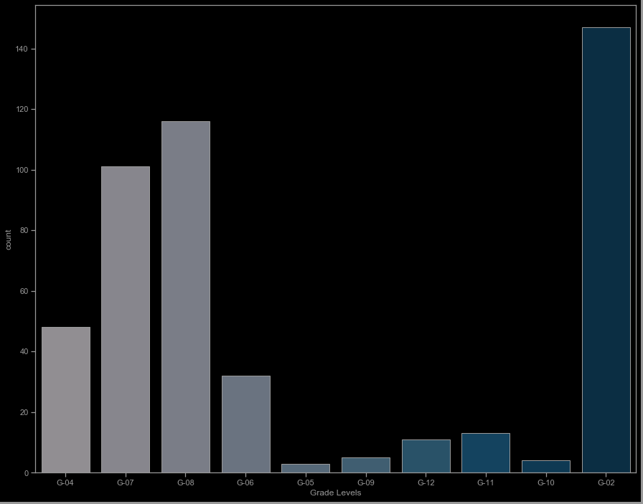
Summary of students surveyed
The dataset consists of 305 males and 175 females.
The students come from different origins such as 179 students are from Kuwait, 172 students are from Jordan, 28 students from Palestine, 22 students are from Iraq, 17 students from Lebanon, 12 from Tunis, 11 students from Saudi Arabia, 9 students from Egypt, 7 students from Syria, 6 students from USA, Iran and Libya, 4 students from Morocco and one student from Venezuela.
The topics enrolled in are IT, French, Arabic, Science, English, Biology, Spanish, Geology, Chemistry, Quran, Math, History
The students are primary and secondary school students between Grade 2 and Grade 12
GRADE LEVEL OF THE STUDENTS SURVEYED

Slide 9
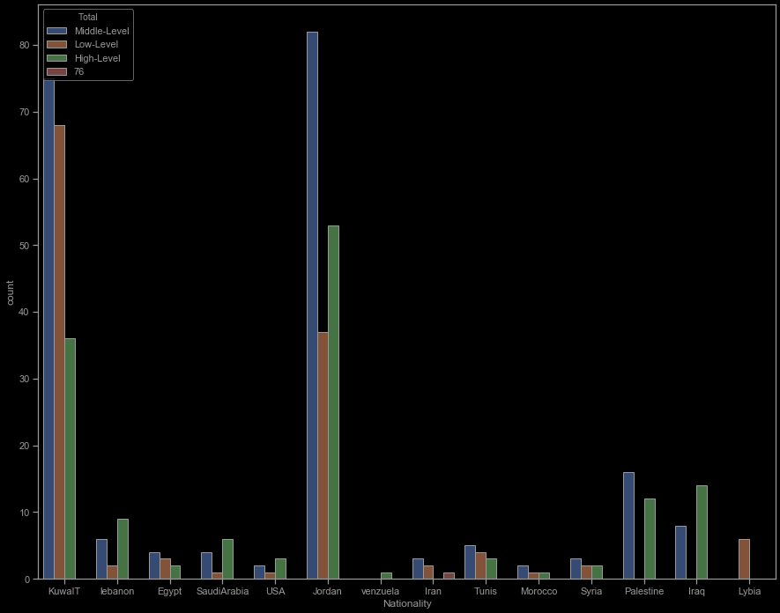
Summary of students surveyed
The dataset consists of 305 males and 175 females.
The students come from different origins such as 179 students are from Kuwait, 172 students are from Jordan, 28 students from Palestine, 22 students are from Iraq, 17 students from Lebanon, 12 from Tunis, 11 students from Saudi Arabia, 9 students from Egypt, 7 students from Syria, 6 students from USA, Iran and Libya, 4 students from Morocco and one student from Venezuela.
The topics enrolled in are IT, French, Arabic, Science, English, Biology, Spanish, Geology, Chemistry, Quran, Math, History
The students are primary and secondary school students between Grade 2 and Grade 12
AVERAGE OF STUDENT PERFORMANCE IN EACH OF THE COUNTRIES

Slide 10
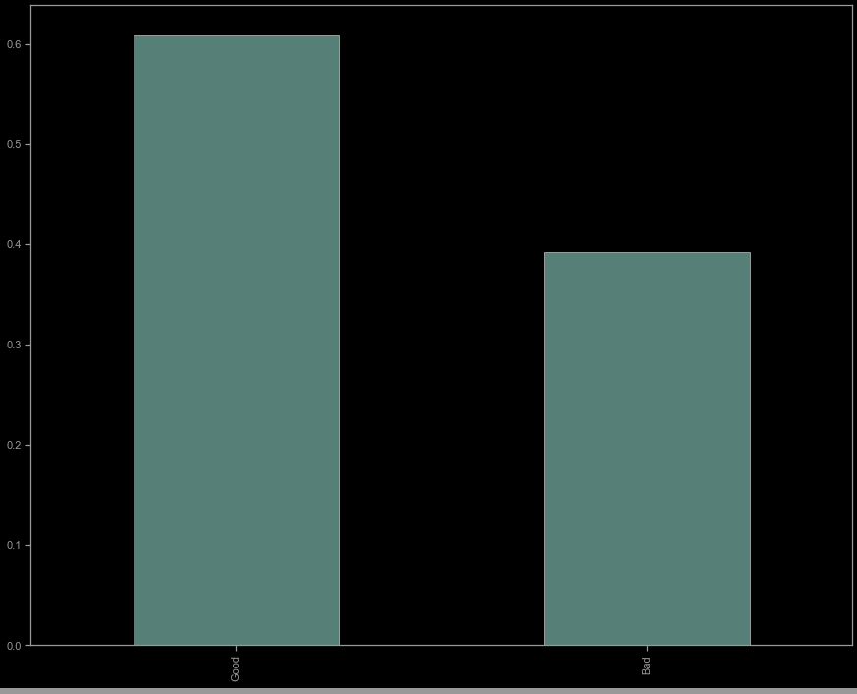
Summary of students surveyed
The dataset consists of 305 males and 175 females.
The students come from different origins such as 179 students are from Kuwait, 172 students are from Jordan, 28 students from Palestine, 22 students are from Iraq, 17 students from Lebanon, 12 from Tunis, 11 students from Saudi Arabia, 9 students from Egypt, 7 students from Syria, 6 students from USA, Iran and Libya, 4 students from Morocco and one student from Venezuela.
The topics enrolled in are IT, French, Arabic, Science, English, Biology, Spanish, Geology, Chemistry, Quran, Math, History
The students are primary and secondary school students between Grade 2 and Grade 12
RATE OF PARENT SATISFACTION IN STUDENTS PERFORMANCE BY THE PARENT

Slide 11
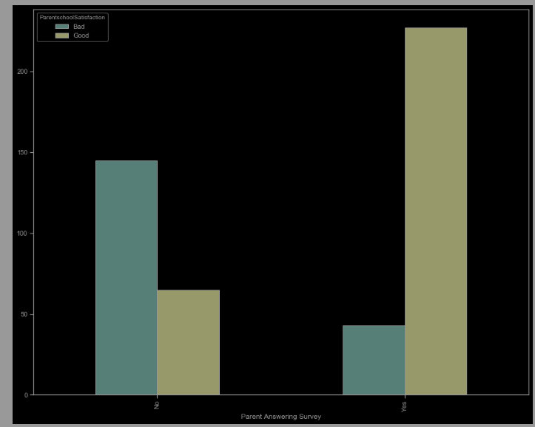
COMPARISON BETWEEN PARENT INVOLVEMENT AND PARENT SATISFACTION
THE DATA INDICATES THAT THERE IS A CORRELATION BETWEEN A PARENT’S SATISFACTION WITH HIS/HER WARD’S PERFORMANCE AND THE PARENT’S INVOLVEMENT IN THE CHILD’S ACADEMICS THROUGH ANSWERING SURVEYS

Slide 12
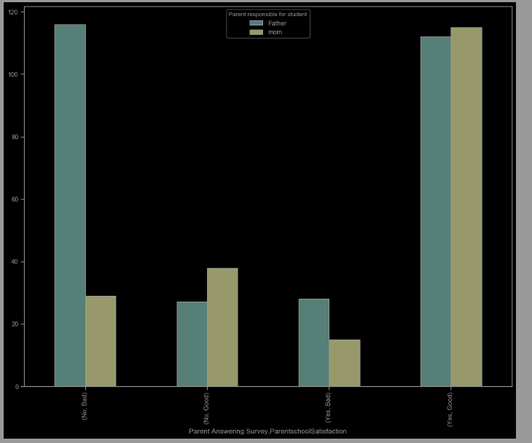
EFFECT OF WHICH PARENT IS RESPONSIBLE FOR A STUDENT’S EDUCATION ON THE STUDENT PERFORMANCE
THE DATA INDICATES THAT STUDENTS WHOSE MOTHERS ARE RESPONSIBLE FOR THEIR EDUCATION TEND TO HARDLY HAVE LOW LEVEL PERFORMANCES AND THEIR PARENTS SATISFACTION IS MOSTLY GOOD

Slide 13


DEDUCTIONS FROM DATA ANALYSIS
From the analysis of the dataset, the summary of the deductions are as follows;
The data indicates that students who were absent from class for more than 7 days tend to have low to mid level performance at best while students who were absent for less than 7 days tend to have high level performance and mid level performance at worst
The data indicates that parent involvement plays a key role in a students overall performance, also mothers have more impact on a child’s performance in school than a father will probably have
The data indicates that female students tend to have high to mid level performances while students with low level performance were mostly male students
The data indicates that there is a correlation between student performance in a particular topic and their participation in class either through raising hands in class or through viewing additional resources or discussing on discussion groups. students who participated a lot in class had high to mid level performance while students with low level performance had not participated as much in class activities.
6th Grade: Basics
7th Grade: Scientific Method
8^{h} Grade: Research
9th Grade: Final Thesis

Slide 14
Thank You

